Slide 1
First Sprint Presentation
Team 34
Jiyang Tao Yumeng Xie

Slide 2
Agenda
Background & Introduction
First Sprint Goals
Progress
Reflection & Problems
Second Sprint Goals

Slide 3
Background & Introduction
People travel a lot and enjoy planning the trip by themselves
A Travel Website
Major Functionalities:
Create own plan
Add time and route manually or using map
Find companions
Search by key words ( Same place at same time)
Share travel notes
Go through other user’s travel notes
Comment & Evaluate & Add To Favorite
Provide recommendations about the hotels and restaurants about the travel place
Notes:
In old days, people used to depend on the travel agency to take care everything for their travel.
They can plan their schedules and find some useful information on the website.

Slide 4
First Sprint Goals
Test how to use Google Map API and Yelp API
How to use API get required data
Display on the corresponding webpage
Implement login and registration functions
Some functionalities can be used by anonymous users
Complete functionalities only can be used by authentication users
Implement homepage and relative functions
Notes:
For the first sprint, we have mainly the following 3 goals

Slide 5
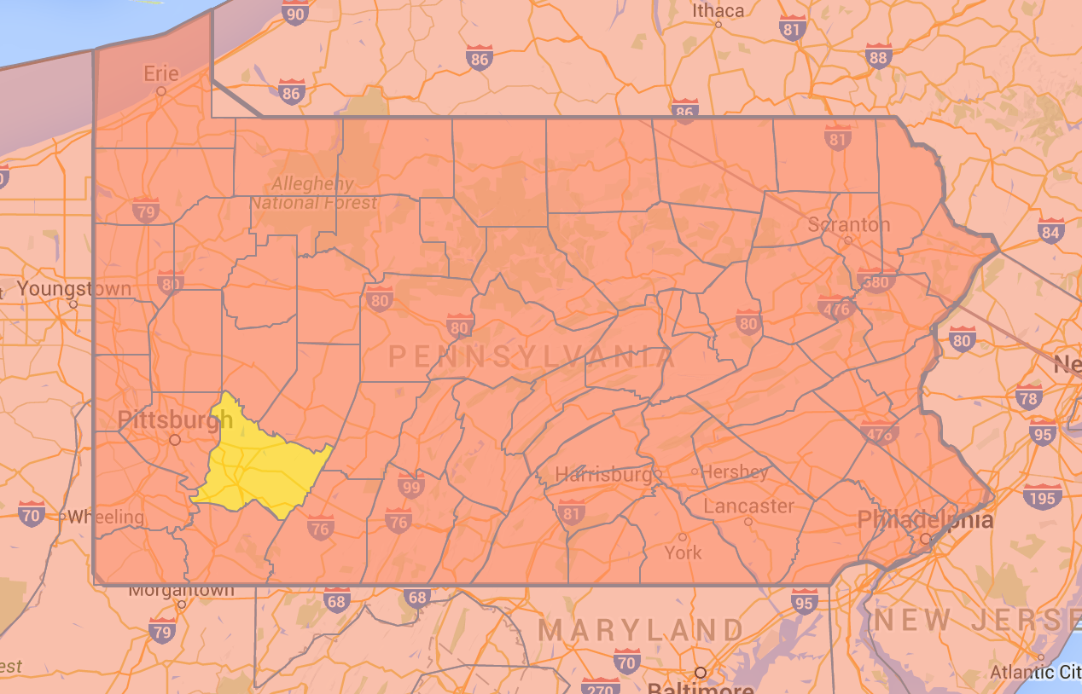
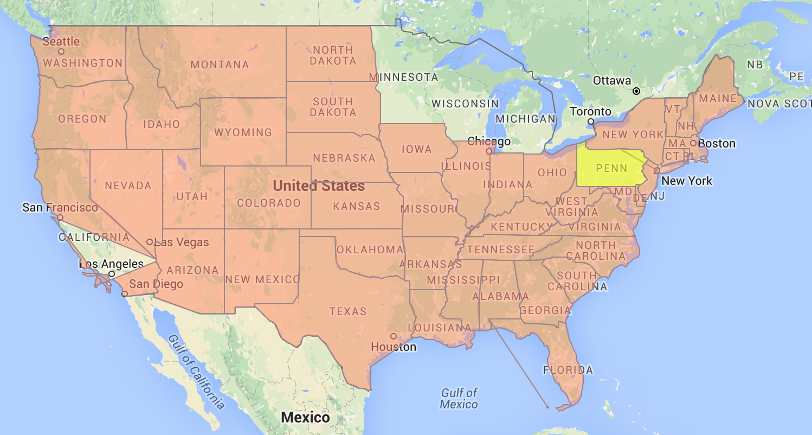
Our Progress
Test how to use Google Map API and Yelp API
Notes:
By now, we have achieve all goals for the first sprint
We integrate the google map Api on our own website

Slide 6
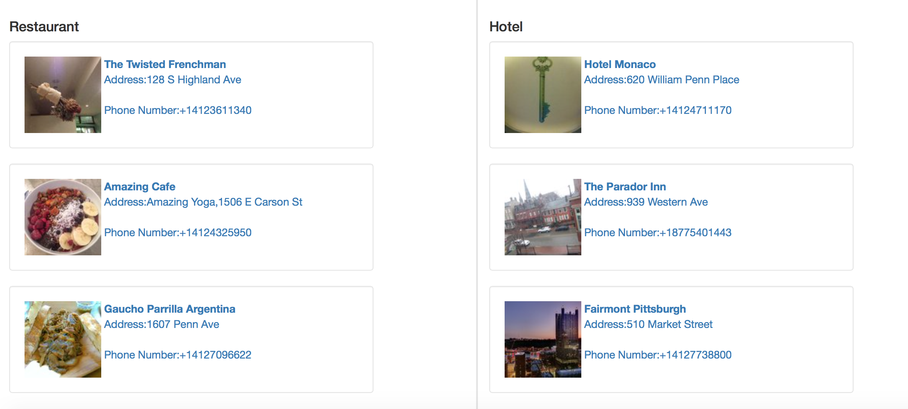
Our Progress
Test how to use Google Map API and Yelp API

Slide 7


Our Progress
Implement login and registration functions
Anonymous User
Homepage, Travel Notes, Travel Plans
Authentication User
Notes:
Code is similar with what we did in the homework
For anonymous users, the identity will show visitor and when they want to use some functionalities that only authentication users can use, they will be asked to login first.
For authentication users, they can use any functionality the website offers.

Slide 8
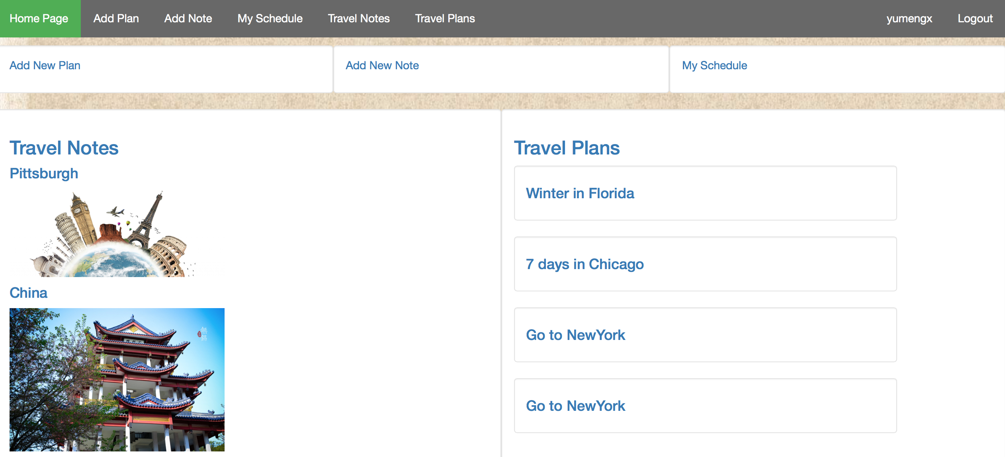
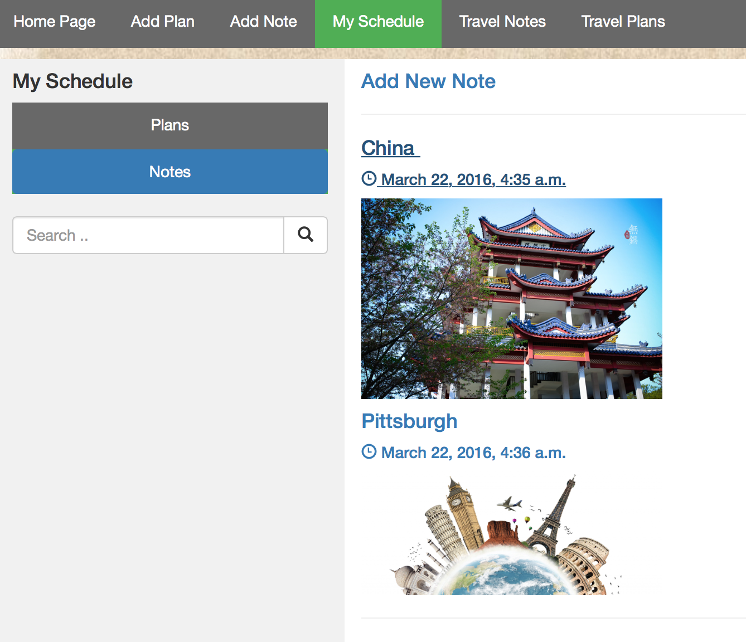
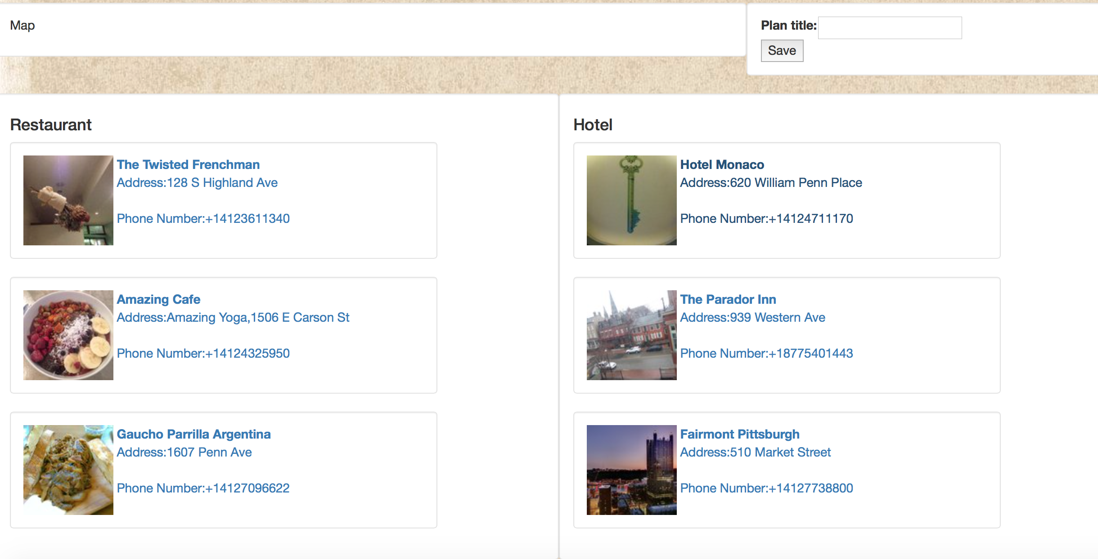
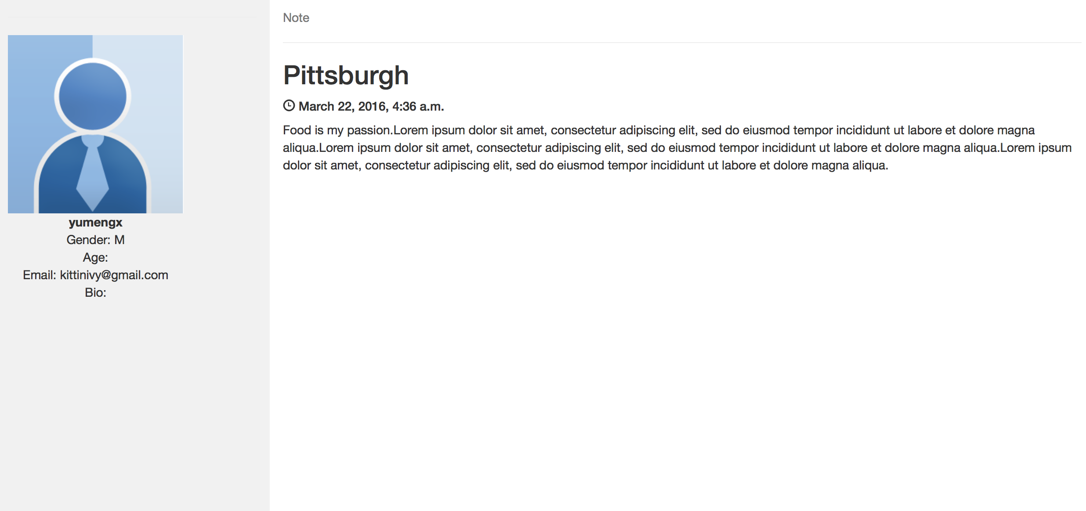
Our Progress
Implement homepage and relative functions
Notes:
This is our homepage, since we didn’t put a lot of effort on the frontend, it may look like a little bit ugly. But we plan to refine the frontend after we implemented all functionalities.
All popular travel notes and travel plans will list on the homepage.

Slide 9
Reflection
Spend time on deciding the topic & Start late
Process(Scrum) is useful
Determine specific goals of the sprint

Slide 10
Problems
How to construct the database?
Each note or plan has multiple time & place pairs. But the number is uncertain.
Scrape the data and store in the database?
Get yelp’s data when calling the function. The latency is high.
Notes:
We are still thinking a good schema of our data table.
By now, when we use yelp API to get data, every time when webpage refreshes, it will call some functions to get the real-time data. It is really slow.
We are thinking about using some other ways to improve the performance. Such as scraping the data and store in the database upfront

Slide 11
Second Sprint Goals
Fix problems
Finish all functionalities
Add new plan & new note
Operations on plan & note
Search companions & note by keyword

Slide 12
Thank YOU!

